Slide 1
Title: NeuroForge Enterprise SDLC Platform

Slide 2
What is NeuroForge Enterprise SDLC Platform?
NeuroForge Enterprise SDLC Platform is an AI-powered Software Development Life Cycle platform that helps organizations manage the complete software development process in a single environment. It allows project managers, business analysts, developers, testers, DevOps engineers, and stakeholders to work together. Instead of depending on many disconnected tools, NeuroForge integrates project management, coding, testing, deployment, and monitoring while using AI to automate repetitive tasks and improve productivity.

Slide 3
Software Development Life Cycle
Software Development Life Cycle, or SDLC, is a structured process used to design, develop, test, deploy, and maintain software. It provides a systematic way of developing software so that organizations can deliver high-quality applications on time, within budget, and with minimum risks. NeuroForge is designed to support the complete SDLC from requirements and planning through development, testing, deployment, monitoring, and maintenance.

Slide 4
PROBLEMS IN TRADITIONAL SOFTWARE DEVELOPMENT
Traditional software development generally depends on multiple tools for requirements, project management, coding, testing, documentation, and deployment. Since these tools may not be properly integrated, communication between teams can become difficult. Documentation is often maintained manually, testing can take more time, and bugs may be detected late. Managers may also have difficulty getting real-time information about project progress, resource allocation, and team productivity.

Slide 5
NEED FOR NEUROFORGE
Why NeuroForge is Required
NeuroForge is required to overcome the limitations of disconnected software development tools. It provides a common environment where different teams can communicate and coordinate their activities. AI can automate activities such as requirement analysis, coding, documentation, testing, and deployment. Automated testing and code reviews can help identify defects and vulnerabilities earlier. Real-time dashboards also provide better visibility into project progress and performance.

Slide 6
OBJECTIVES
The main objective of NeuroForge is to streamline the complete software development process using AI and automation. It aims to reduce repetitive manual work and improve communication between different development teams. The platform also focuses on improving software quality through automated testing and code reviews. Another important objective is to provide real-time project information and integrate AI with CI/CD and DevOps tools to support faster and more efficient software delivery.

Slide 7
CORE FEATURES
NeuroForge provides several modules covering different stages of software development. Requirement management allows teams to collect and track requirements, create user stories, and plan sprints. AI-powered development supports requirement analysis, code generation, documentation, and intelligent code suggestions. Source-code management provides Git integration, version control, pull requests, and code reviews. Testing modules support automated testing and bug detection, while deployment and monitoring provide CI/CD, cloud deployment, performance analytics, and real-time monitoring

Slide 8
USERS OF THE SYSTEM
NeuroForge supports multiple users involved in software development. The System Administrator manages accounts, roles, permissions, and security. The Project Manager manages schedules, tasks, resources, and project progress. The Business Analyst collects and analyzes requirements, while the Product Owner manages product priorities. The Software Architect designs the system architecture, the Developer develops the application, the QA Engineer performs testing, and the DevOps Engineer manages CI/CD and deployment. Clients and stakeholders review progress and provide feedback.

Slide 9
AGILE METHODOLOGY
Development Methodology
The NeuroForge project follows the Agile Software Development Methodology. Agile divides the project into smaller iterations called sprints instead of developing the entire system at once. Each sprint focuses on a specific set of features and ends with testing, review, and improvement. The proposed development plan consists of four sprints, with each sprint lasting two weeks, making the total project duration eight weeks.

Slide 10
MODULE ARCHITECTURE & DEVELOPMENT PLAN
System Modules and Sprint Plan
NeuroForge consists of interconnected modules that support the complete Software Development Life Cycle, starting from user authentication and project management and continuing through requirements, development, testing, deployment, monitoring, and maintenance. The platform is developed using the Agile methodology and is divided into four two-week sprints.
Sprint 1 – Foundation & Project Management (Weeks 1–2): User authentication, role-based access control, user management, requirement management, project planning, sprint creation, and task assignment are implemented to establish the basic platform foundation.
Sprint 2 – Development & Collaboration (Weeks 3–4): Task management, AI-powered code generation, documentation, Git integration, version control, and team collaboration are developed to support efficient software development.
Sprint 3 – Testing & DevOps (Weeks 5–6): Automated testing, bug tracking, code review, AI-based code quality analysis, CI/CD pipelines, and automated deployment are implemented to improve software quality and delivery.
Sprint 4 – Monitoring & Final Deployment (Weeks 7–8): Real-time dashboards, performance monitoring, reporting, analytics, maintenance, final system integration, User Acceptance Testing, and production deployment complete the platform.

Slide 11
SRS, REQUIREMENTS & TECHNOLOGY STACK
Software Requirements Specification
The Software Requirements Specification (SRS) defines the purpose, scope, functions, quality requirements, users, technologies, and expected outcomes of the NeuroForge platform. It covers the complete software lifecycle, including requirement gathering, development, testing, deployment, monitoring, and maintenance.
Functional Requirements
NeuroForge provides secure authentication and role-based access, requirement and project management, task and sprint management, AI-assisted code generation, automatic documentation, Git integration, automated testing, bug tracking, CI/CD pipelines, dashboards, analytics, and performance monitoring.
Non-Functional Requirements
The system is designed to provide high performance, security, scalability, reliability, and usability. It supports multiple users, protects data through authentication and encryption, provides backup and recovery, and offers a responsive and user-friendly interface.
Technology Stack
The proposed stack includes React.js/Angular for frontend, Spring Boot/Node.js for backend, and PostgreSQL/MongoDB for databases. Git, GitHub/GitLab, Jenkins, Docker, Kubernetes, AWS/Azure/Google Cloud support version control, DevOps, and deployment. OpenAI API, TensorFlow/PyTorch support AI, while Prometheus and Grafana provide monitoring.

Slide 12
UML
Unified Modeling Language
UML stands for Unified Modeling Language. It is a standard graphical language used to visualize, design, document, and communicate the structure and behavior of a software system. UML allows developers and stakeholders to understand the system before implementation. It also helps identify design problems early and provides documentation that can be useful during future maintenance and upgrades.
TYPES OF UML DIAGRAMS
UML diagrams are mainly used to represent the structure and behavior of a system. Structural diagrams represent the static structure of the system, such as classes, components, packages, and deployment. Behavioral diagrams represent how the system behaves and how users and components interact with it. For NeuroForge, important diagrams include Use Case, Activity, Sequence, Class, and ER diagrams.

Slide 13
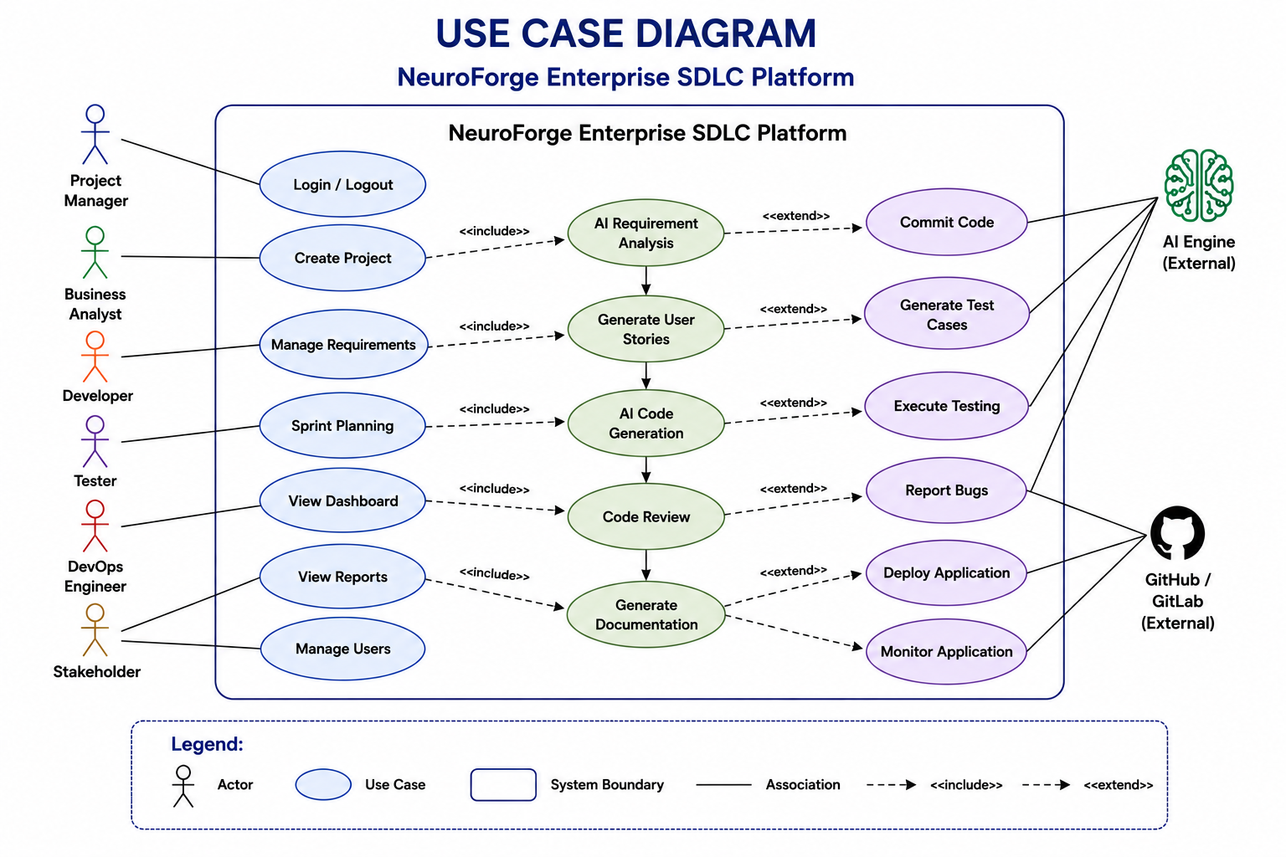
USE CASE DIAGRAM

Slide 14
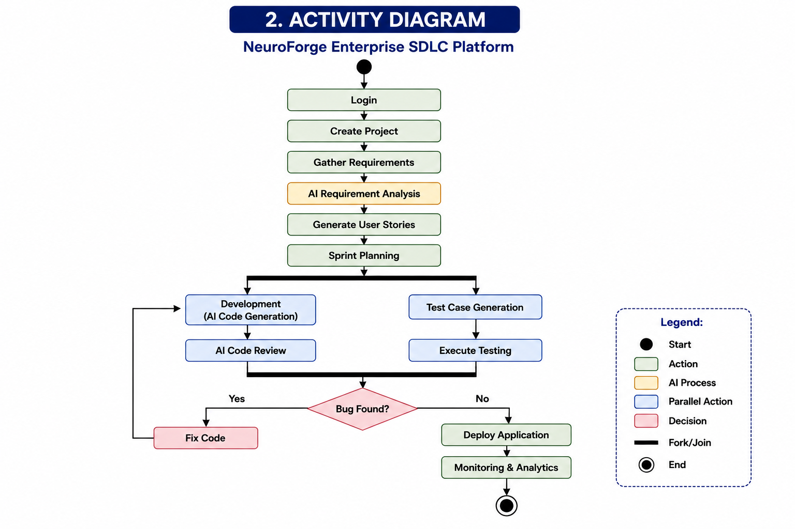
ACTIVITY DIAGRAM

Slide 15
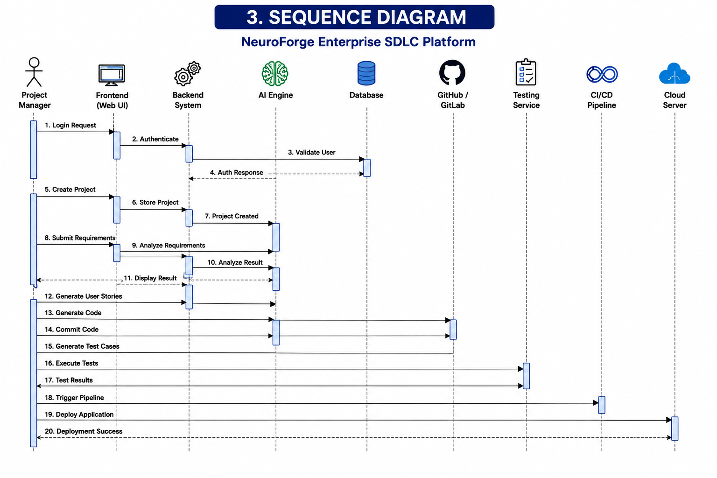
SEQUENCE DIAGRAM

Slide 16
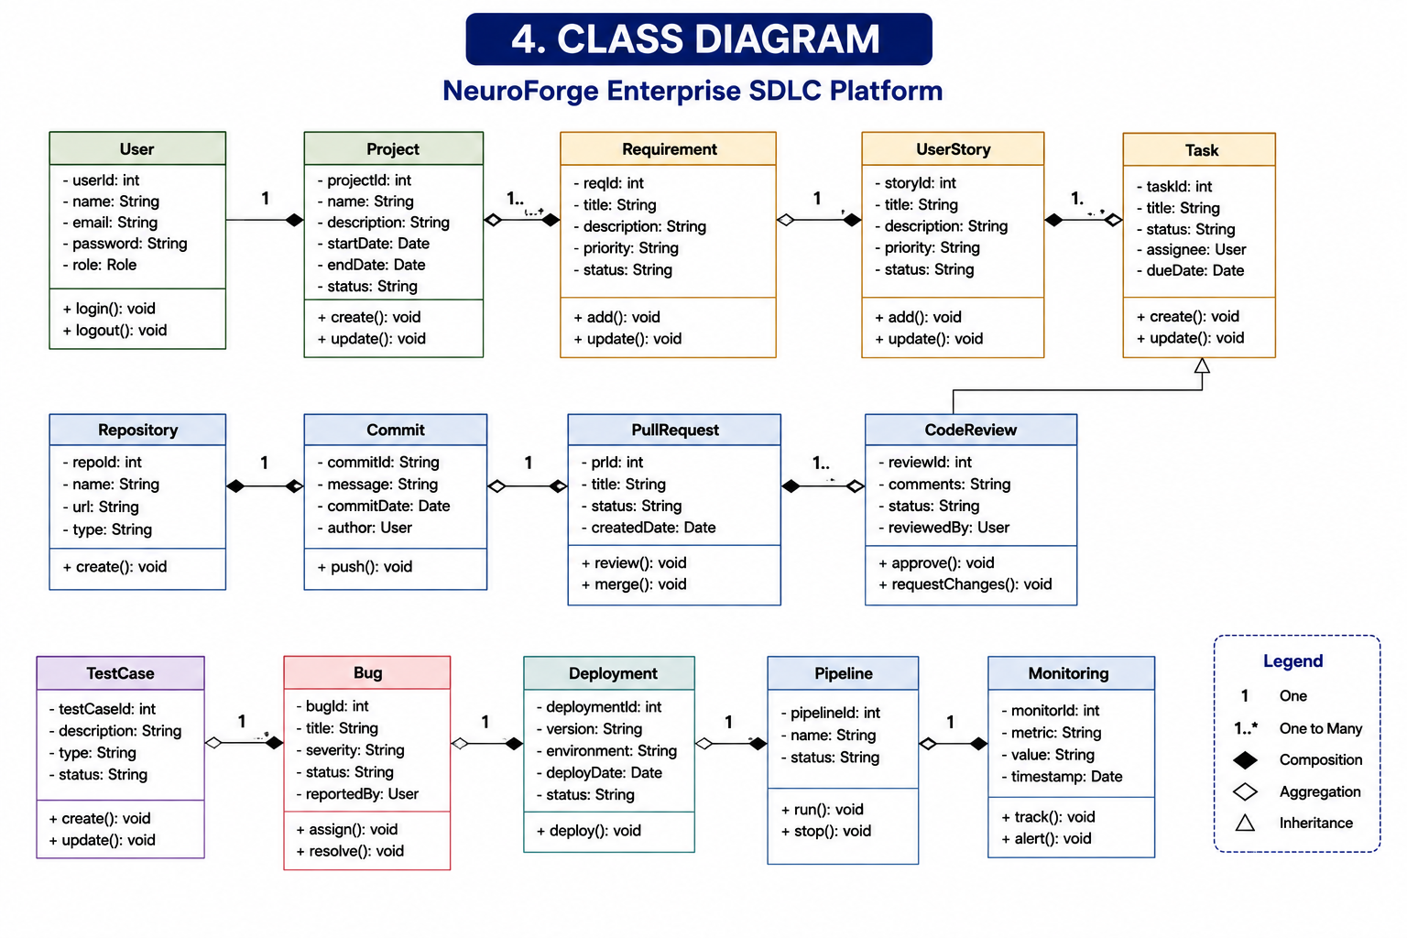
CLASS DIAGRAM

Slide 17
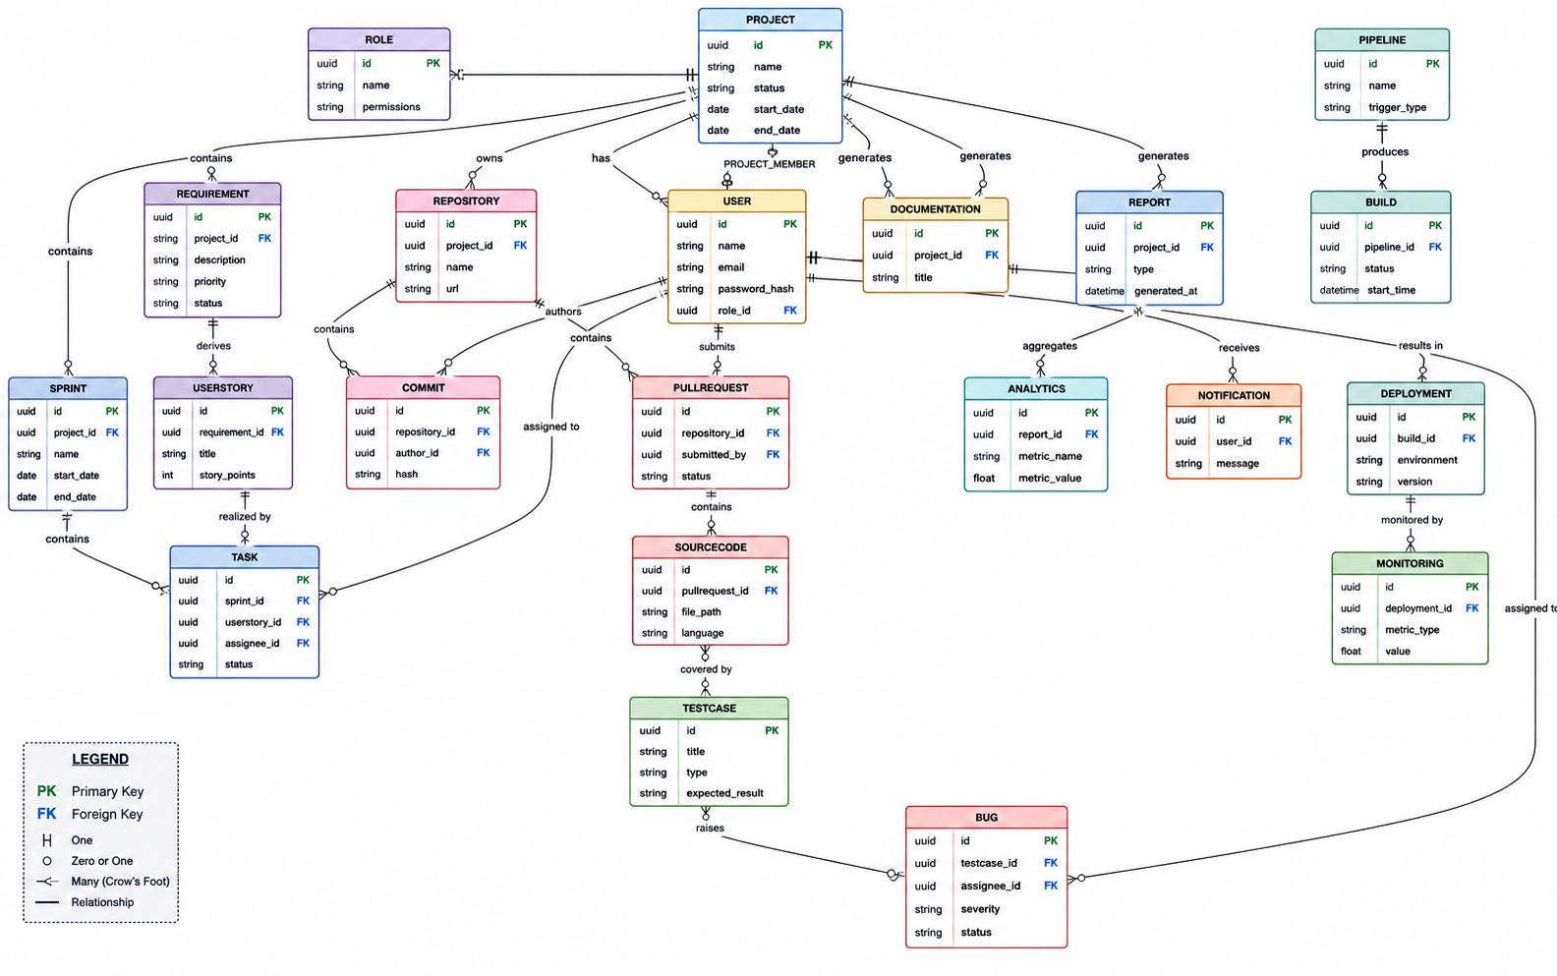
ER DIAGRAM

Slide 18
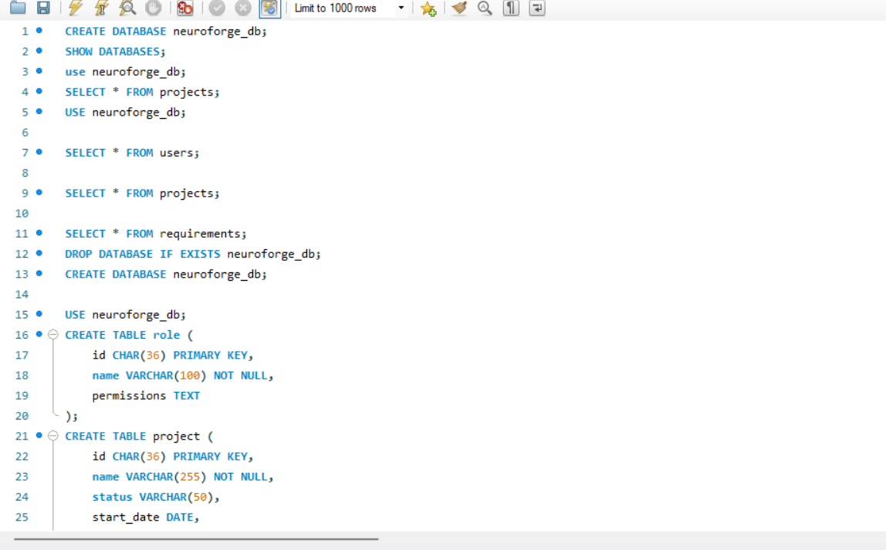
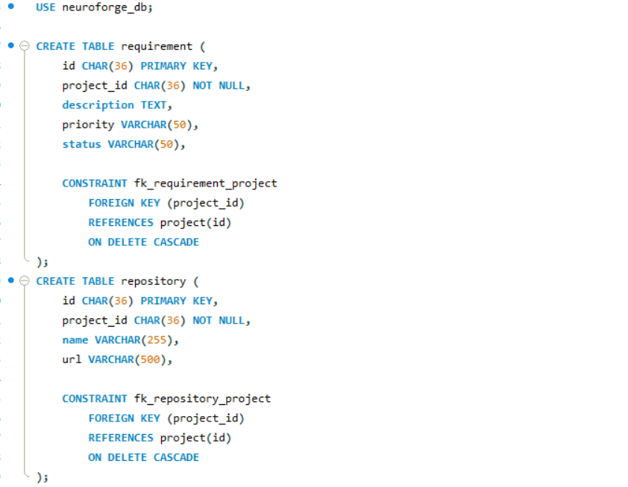
DATABASES

Slide 19
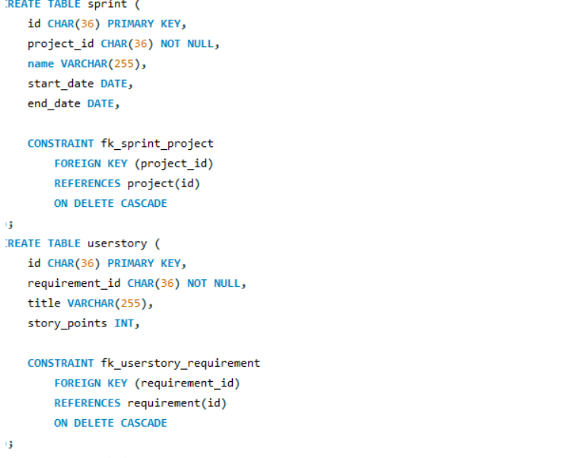
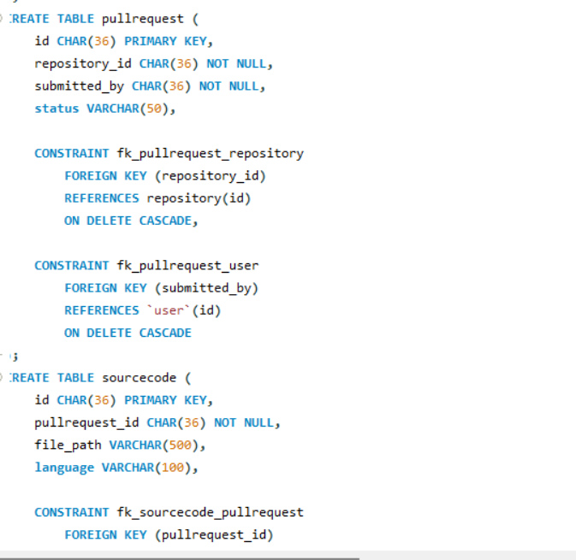

Slide 20
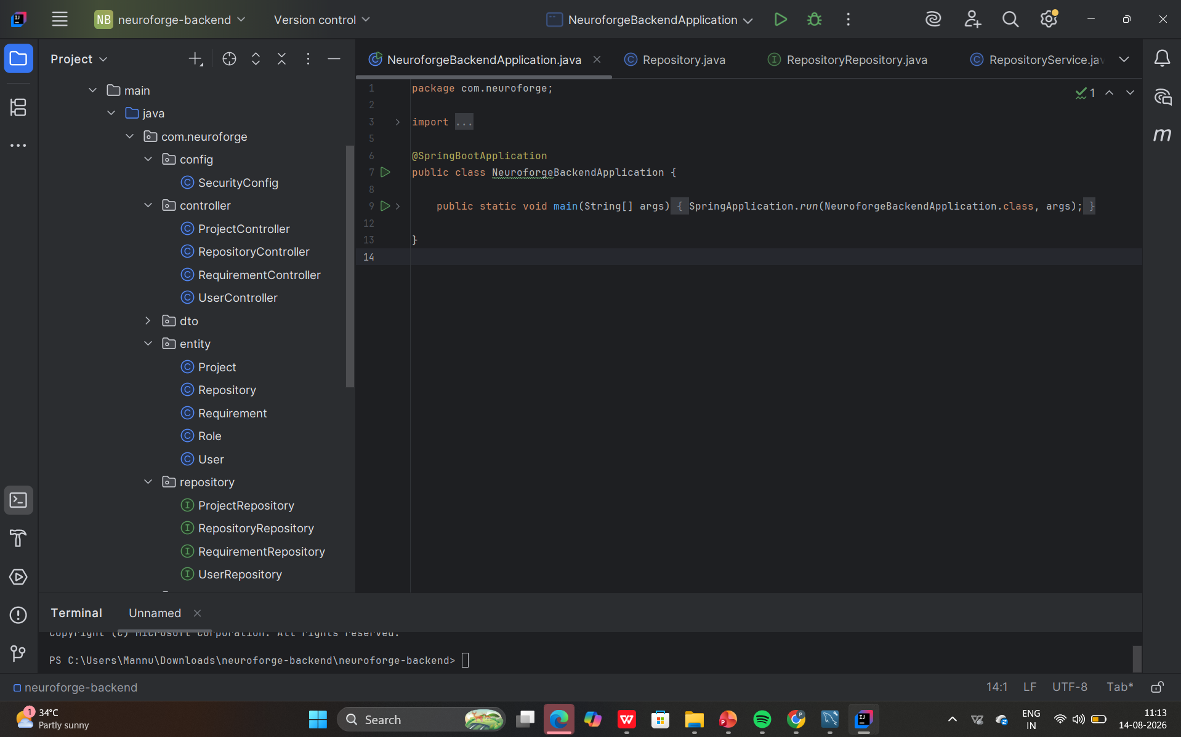
BACKEND DEVELOPMENT

Slide 21
CONCLUSION
NeuroForge Enterprise SDLC Platform provides an integrated environment for managing the complete Software Development Life Cycle, from requirement gathering and project planning to development, testing, deployment, monitoring, and maintenance. The platform uses Agile methodology and combines project management, AI-assisted development, Git integration, automated testing, CI/CD, monitoring, and analytics to improve collaboration, reduce manual effort, increase software quality, and support faster software delivery.
The implemented Spring Boot backend follows a layered architecture with controllers, services, repositories, entities, DTOs, and security configuration. The database layer manages important system data such as users, roles, projects, repositories, and requirements, while repository interfaces provide communication between the backend and database. Together, the frontend, backend, database, AI capabilities, version control, testing, and DevOps components provide a strong foundation for a centralized and scalable SDLC platform.

